Slide 1
Session 6: Institutional Investors and the Asset Management
Amine Raboun, Ph.D
Quantitative Researcher & Developer,
Abu Dhabi Investment Authority
Lecturer, Paris Dauphine – PSL University

Slide 2
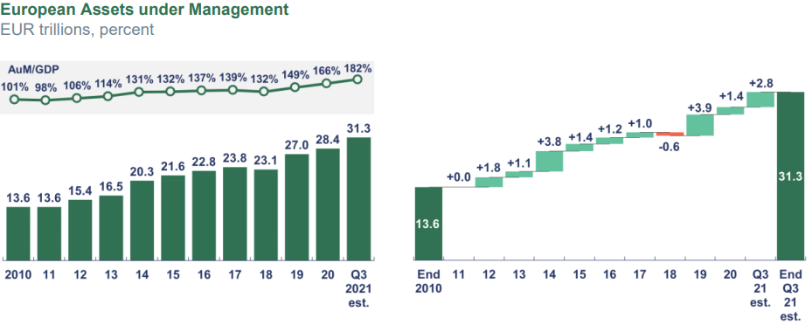
A Huge and Growing Market

Slide 3
Outline: Asset Management
The role of Asset Management in the Financial System
The Contact Point between Financial System and the Real Economy
Intermediation by Asset Managers
Overview of the Asset Management Industry
Concentration at different levels
Concentration of Assets towards a Few Actors
Concentration of Assets towards a Few Strategies
Recent Trends in Investing
ESG a new regulatory requirement
Factor Investing
Smart Beta

Slide 4
The rôle of Asset Management in the Financial System

Slide 5
The rôle of Asset Management
Channeling long-term savings into the economy
Helping people provide for their future
Offering investment solutions to retail and institutional investors
Managing risks
Acting in the best interest of investors
Representing the largest investors in capital markets
Playing a key role in financing the transition to a sustainable economy
Engaging with investee companies and holding them to account

Slide 6
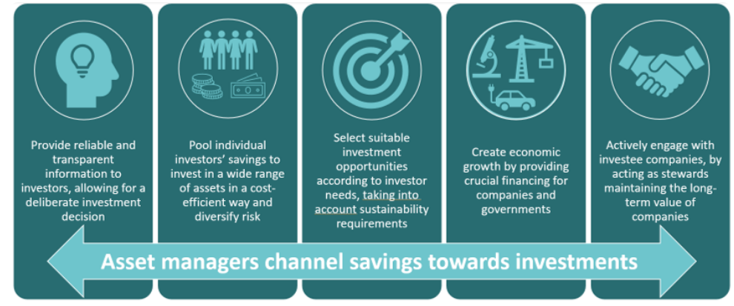
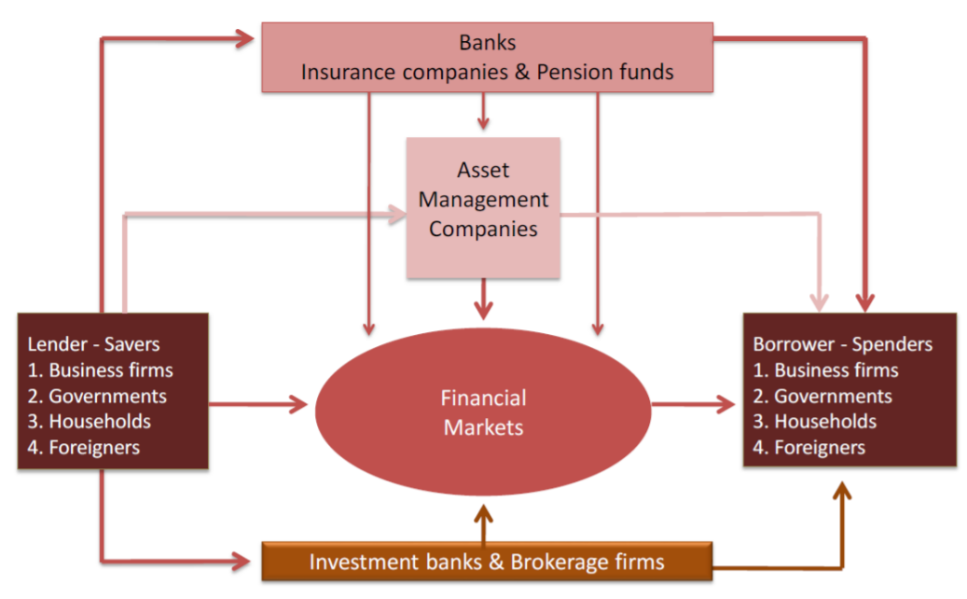
Channeling long-term savings into investments
Long term efficiency: Allocate savings to most porductive investments
Short term efficiency: Do better than average/ competitors

Slide 7
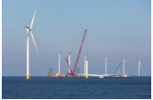





Financing the transition to a sustainable economy
Climate Change Mitigation
The European Taxonomy of Sustainalble Activities
To be taxonomy-eligible, an economic activity must go through 4 steps:
Contribute substantially to one or more of the 6 environmental objectives
Do no significant harm to any other environmental objective
Comply with minimum social safeguards (ILO core labour conventions)
Comply with the technical screening criteria
Climate Change Adaptation
Sustainable Use and Protection of Water and Marine Ressources
Substantial contribution to climate change mitigation
generating, storing or using renewable energy or climate-neutral energy (including carbon-neutral energy), including through using innovative technology with a potential for significant future savings or through necessary reinforcement of the grid;
switching to use of renewable materials; The first delegated act under the Taxonomy will focus on climate change mitigation and adaptation activities. In later steps, it is planned to address social and ethical aspects.
improving energy efficiency;
increasing clean or climate-neutral mobility;
increasing carbon capture and storage use;
phasing out anthropogenic emissions of GHG, including from fossil fuels;
establishing energy infrastructure required for enabling decarbonization of energy systems;
producing clean and efficient fuels from renewable or carbon-neutral sources.
Transition to a Circular Economy and Recycling
Pollution Prevention and Control
Protection of Healthy Ecosystems

Slide 8
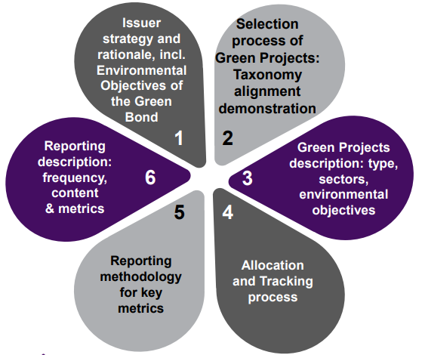
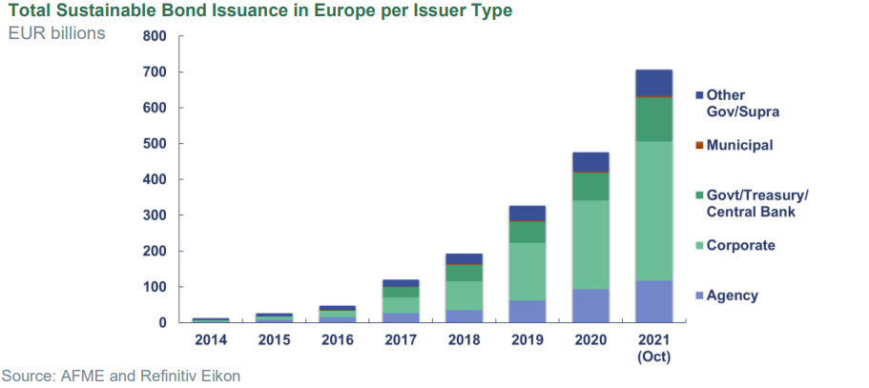
Financing the sustainable economy
EU Taxonomy: Green bond Framework
Sustainable (ESG) bonds are designed to exclusively finance or re-finance green and, or social projects.
The sustainable bond market has seen exponential growth during the last decade.
The fiscal policy response to the Covid-19 pandemic led to a significant rise in the issuance of green bonds

Slide 9

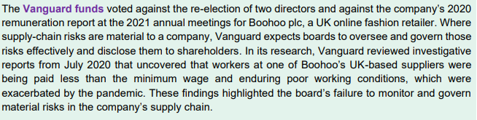
Engaging with investee companies and holding them to account
Stewardship: Regular engagement with publicly listed investee companies in order to deliver long-term value creation for shareholders in the company. Asset managers have two main tools to achieve their stewardship goals:
Engagement: asset managers engage with company management or board members to raise any concerns, encourage good practices, and to understand the extent to which management is delivering sustainable returns for shareholders.
Proxy voting: asset managers participate in general meetings and take part in the votes on behalf of their clients

Slide 10
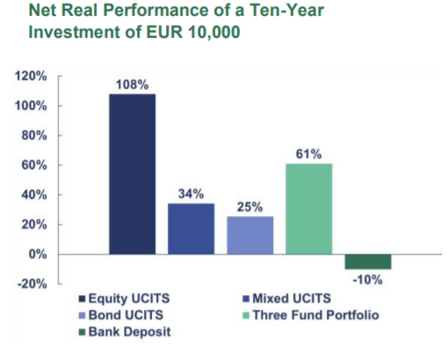
Intermediation by Asset Managers
Serving the need of Asset Owners
Lower investment risk: By achieving the right level of diversification and providing access to a broad range of asset classes. The purpose is to screen out poor investment opportunities and detect those that are potentially advantageous thanks to quality research they have access to.
Liquidity provision: Closely monitor the evolution of inflows and outflows and market dynamics to anticipate the risk of rapid and large net outflows. They also have established risk management policies to ensure that they are able to meet their liquidity provision obligation when difficulties in financial markets occur.
Lower costs: Asset managers benefit from economies of scale that households and other investors don’t have. For instance, the ability to trade in large blocks of securities allows them to minimize transaction costs.
Generating returns: By channeling savings into investment, asset managers help asset owners achieve positive real returns on their savings.

Slide 11
Overview of the Asset Management Industry

Slide 12
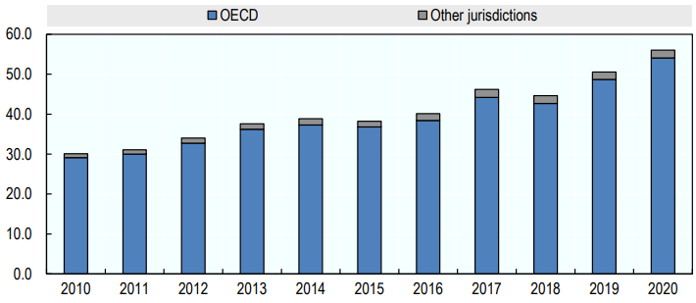
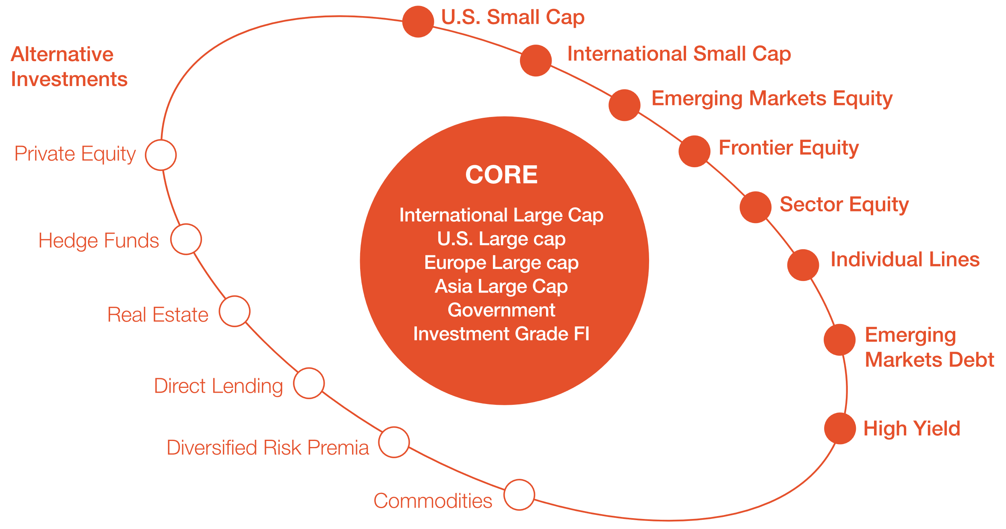
Overview of the Asset Management Industry
Pension Funds:Typical example of long-term investors
Partially due to the baby boom, the pension funds have experienced steady growth in AUM in the last decade
Core strategies with exposure to asset classes that are broadly representative for the market
Satellite strategies that have the potential to deliver higher returns from less representative parts of the investment universe.

Slide 13
Overview of the Asset Management Industry
Mutual Funds at the service of Pension Funds
Pay-As-You-Go Pension System: Redistribution system. Current workers contributions are redistributed in the form of pension to current retirees. Because of aging population this scheme of pension is very criticized
Risk shifting from Employers to Employees:
Defined benefit: The employer guarantees the level of benefits agreed, based on the employee’s salary and seniority. These plans can be managed internally or delegated to mutual funds. However, companies no longer want to bear such immense risk
Defined contribution: The employer agrees to pay regular contributions to a management organization, which, together with the income generated by their investment, will be paid out in the form of an annuity to retired employees. The employer does not provide any guarantee on the level of annuities paid.
The principal agent problem: How does one explain the difference between the few basis points of compensation for an ETF and the 2/20 compensation system for active funds?
Bengt Holmstrom and Paul Milgrom in the late 1980s coined the expression: Principal Agent. If the reward is fixed only, the agent can receive it without any effort. Variable only won’t work, as the manager have fixed costs to pay. How to set the variable part ? The asset owner would like to have observables to index the reward. But doing so, the managers will work to satisfy these indicators and not fructify the money of the asset owner

Slide 14
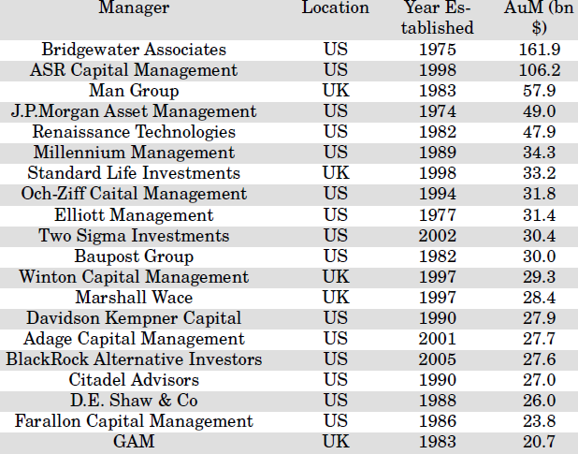
Overview of the Asset Management Industry
Hedge Funds (or Alternative Investments)
Well connected to the system: Majority of hedge funds are, or were, subsidiaries of intermediaries, including investment banks and mutual funds. This allows them to make use of other financial institutions; they often need to short certain risk factors or hedge non-linear securities
As their name suggest, the provide strategies hedged from market variations. Thus, in the CAPM terminology, providing alpha and neutralizing the Beta (in all its shapes)
Identify persistent statistical relationships between financial instruments (Peer trading, statistical arbitrage..)
Use alternative set of data to research the real economy live time evolution NOWCASTING. Satellite images, credit card bills, mobiles trackers, factory production, patents, etc.)
Research based on high-level experts (either scientific and field experts) to identify the future trends in the industries (Pharmaceutical Research)

Slide 15
Overview of the Asset Management Industry
The rest of the industry
Sovereign Funds: Most of them, such as the Norwegian fund or the Abu Dhabi Investment Authority, derive their allocations from surplus revenues from the oil sector. Sovereign funds are similar to endowments in that they aim to provide dividend-like income to their host countries. They are very long-term investors and can therefore theoretically bear more risk than other types of investment structures
Endowment Funds: The endowment logic consists of generating enough real returns to meet the organization’s yearly expenses while preserving the real value of the principal. This means that the returns generated must cover annual withdrawals and increase the principal to offset inflation.
Insurance Companies: Their core business is not related to money allocation but risk transfer and management. Hence, by selling insurance contracts, they take on their clients’ risk in exchange for a premium plus fees and margins. They also need to either transfer such risk to another counterparty with the exact opposite risk or to dilute it on the financial markets.
Wealth Management: High net worth individuals (HNWI), have so much savings that commercial and investment banks started to provide them with specific investment vehicles. These individuals have no urgency for outflows, or these are highly predictive, hence they can afford to invest in illiquid assets like endowment funds do

Slide 16
Winners Take it All ! Concentration at different levels

Slide 17
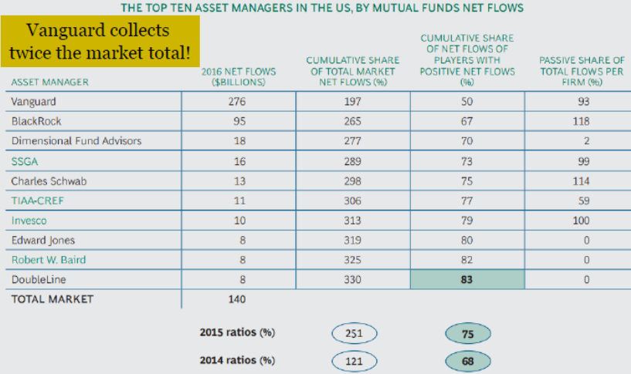
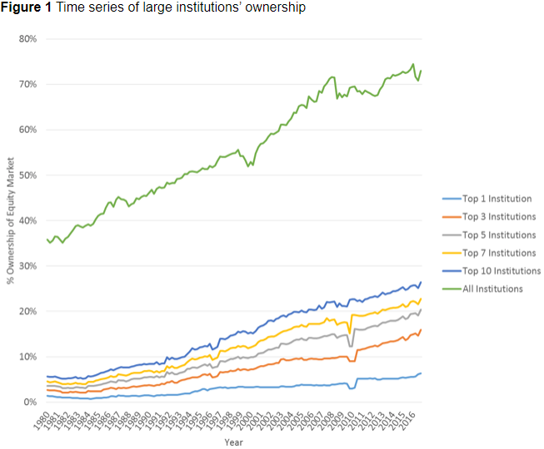
Concentration of Power Within a Handful of Asset Managing Companies
Giant asset managers are building on their client base to become “one-stop shops” offering a wide range of investment vehicles, going from ETFs to hedge funds.
Investment diversity in terms horizons and themes is necessary to cover all possible sources of information. Otherwise, all flows will be on the same side (buying or selling), and the price will be pushed artificially.
Concentration for economies of scale: The cost for data, the hiring of field experts and data-scientists to exploit them is recouped
Blackrock and Vangard got 265% of positive Net flows in 2016. Apart these two firms, all smaller asset managers suffered from outflows. Thus, getting smaller every year
Winners take it all. From the new-comer perspective, the bigger the fund the more trust-worthy in managing his savings.

Slide 18
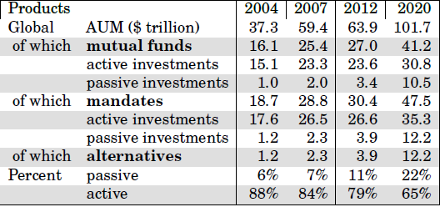
Passive Investing Takes Over Active Allocation
The global financial crisis (2008 - 2009) was the tipping point for the shift from active to passive management.
Prior to 2010, the doxa was that rewarding strategies uncorrelated to the market factor would either fail to cover their costs or would correct themselves once invested by a sufficient number of participants (giving rise to alpha decay).
More recent academic output suggested that it is not always the case, which opened up older hedge fund strategies to the public domain, being repackaged in ready to use investment tools like ETFs.

Slide 19
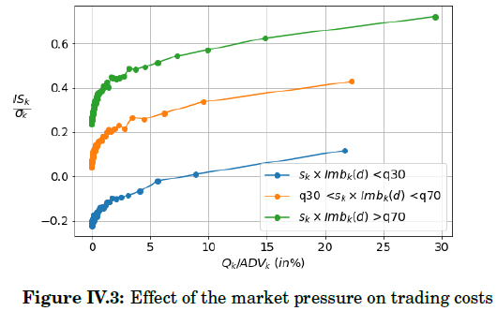
Crowdedness And Transaction Costs
The crowding of the trading flow can influence the transaction costs. if on a given day, all market participants are buying, then the square root component of the sum of the trades of all the participants is paid by each of them.
Concentration is beneficial in this case. If all trades are managed by the same dealing desk , he can have a fine tooned exécution algorithm
The advantage of offering a wide range of investment vehicles is that it increases the probability of crossing the buys and sells within the same asset management firm, marking the price outside the firm (to avoid advantaging one vehicle over another in the transaction), achieving lower information leakage and lower cost (free from market-impact).

Slide 20
Recent Trends

Slide 21
What Explains Asset Returns ?
Factor models
Macroeconomic factors :
related to the context of utilisation rather in the econometric technique
realizations of Ft are assumed to be observed : macroeconomic time-series mainly
estimation involve classical econometric tools
Statistical factors :
factors as by-product of the statistical study of the covariance matrix of returns
factors emerge directly from the observation of past returns of assets
neither the betas, neither the factors are observed.
Both emerge due to assumptions on R or on the covariance structure.
Fundamental factors :
focus on ex-ante information, on characteristics like sector, country, industry, or financialstatements (income, revenues, assets, etc).
stocks characteristics help to build the risk drivers (6= two other models).
One type of model assumes that the betas are observed...
... the other use characteristics to estimate first factors, before estimating betas.
Factors remain initially unobserved.

Slide 22
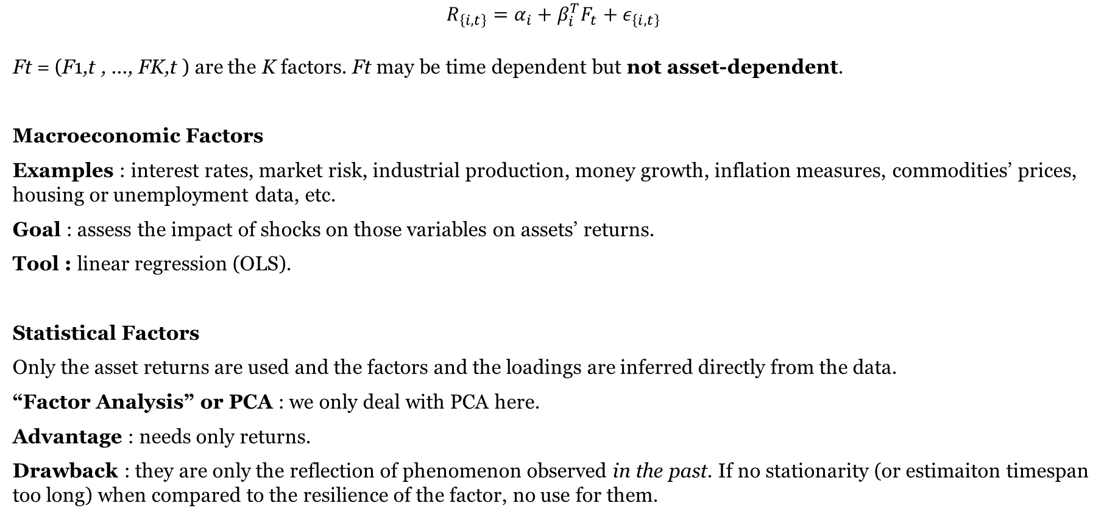
What Explains Asset Returns ?
$$R_{\left\{i,t\right\}}=α_{i}+β_{i}^{T}F_{t}+ε_{\left\{i,t\right\}}$$
Ft = (F1,t , ..., FK,t ) are the K factors. Ft may be time dependent but not asset-dependent.
Macroeconomic Factors
Examples : interest rates, market risk, industrial production, money growth, inflation measures, commodities’ prices, housing or unemployment data, etc.
Goal : assess the impact of shocks on those variables on assets’ returns.
Tool : linear regression (OLS).
Statistical Factors
Only the asset returns are used and the factors and the loadings are inferred directly from the data.
“Factor Analysis” or PCA : we only deal with PCA here.
Advantage : needs only returns.
Drawback : they are only the reflection of phenomenon observed in the past. If no stationarity (or estimaiton timespan too long) when compared to the resilience of the factor, no use for them.

Slide 23
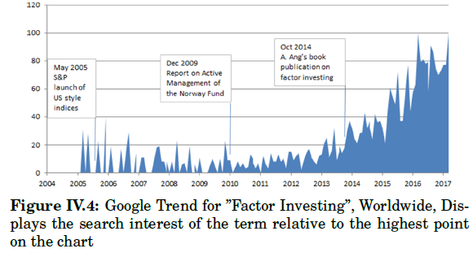
Recent trends in investing
Fundamental factors :
Small Size: Small (large) capitalization is over (under)-weighed compared to the benchmark. Small-capitalization premium is usually linked to an illiquidity premium since small stocks are costlier to trade.
Quality/profitability: Captures excess returns of stocks that are characterized by low debt, stable earnings growth, and significant investment returns.
Low volatility: seeks to benefit from the performance of stocks with lower risk, while maintaining a high return.
Momentum: “Buy the winners (well performed recently) and sell the losers (recently under performed)”.
Value: Buy undervalued stocks and sell overvalued ones. The Price over Earnings ratio is a closely watched indicator
Dividend Yield: Related to quality and value factors, since companies capable of paying large dividends are often the more profitable ones

Slide 24
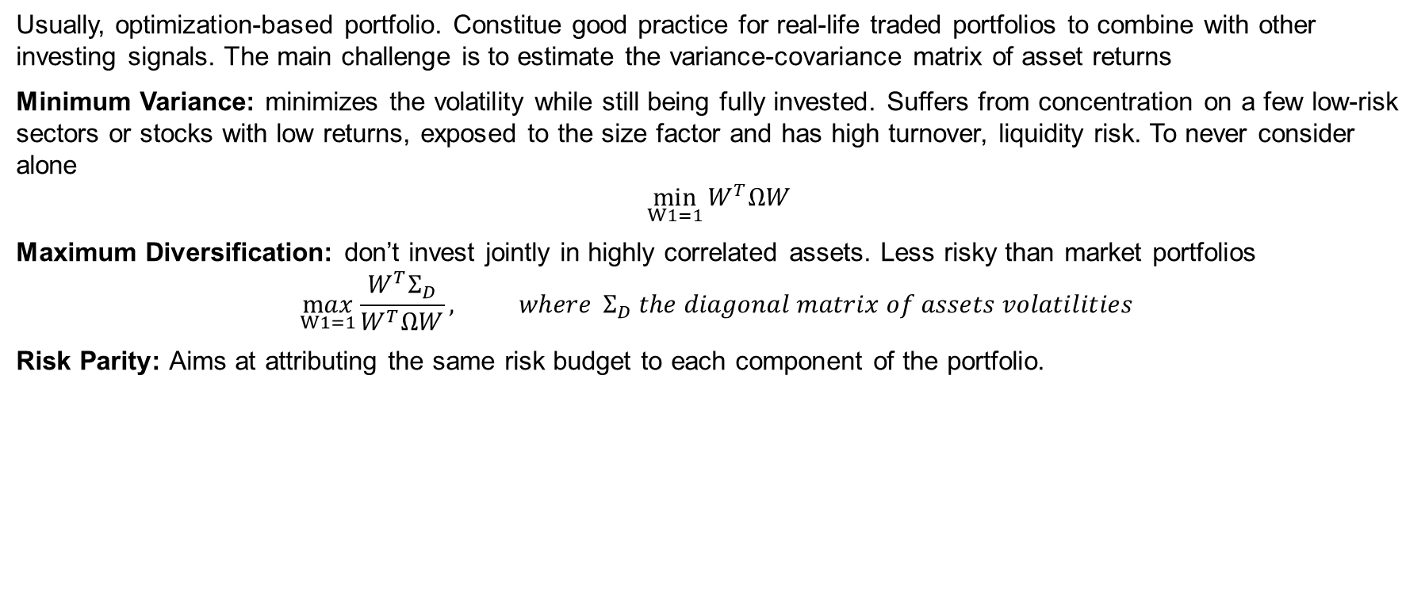
Recent trends in investing
Smart Beta Strategies
Usually, optimization-based portfolio. Constitue good practice for real-life traded portfolios to combine with other investing signals. The main challenge is to estimate the variance-covariance matrix of asset returns
Minimum Variance: minimizes the volatility while still being fully invested. Suffers from concentration on a few low-risk sectors or stocks with low returns, exposed to the size factor and has high turnover, liquidity risk. To never consider alone
$$\min_{W1=1}{W^{T}ΩW}$$
Maximum Diversification: don’t invest jointly in highly correlated assets. Less risky than market portfolios
$$\max_{W1=1}{\frac{W^{T}Σ_{D}}{W^{T}ΩW}, where }Σ_{D} the diagonal matrix of assets volatilities$$
Risk Parity: Aims at attributing the same risk budget to each component of the portfolio.

Slide 25
Recent trends in investing
ESG Investing
Strategies used:
Negative/exclusionary screening: Exclusion of securities of certain sectors or companies involved in controversial activities
Positive/best-in-class screening privileges the best performers within a sector or a geographical zone in terms of ESG.
Impact investing. Targeted investments aimed at solving social or environmental problems. Investments in particular projects designed to achieve specific goals
PAB (Paris Aligned Benchmark)/CTB (Climate Transition Benchmark) combines all the approaches
 | EU Climate Transition | EU Paris-Aligned
Do not Significantly harm principle | Controversial Weapons Societal norms violatros | Controversial Weapons Societal norms violatros Activity Exclusions (Coal, Oil, Gas…)
Carbon Intensity reduction vs universe | 30% | 50%
Exposure to High Impact sectors | Minimum exposure to sectors highly exposed to climate change issues
Year-on-year self-decarbonization of the benchmark | At least 7%: in line with or beyond the decarbonization trajectory from the IPCC’s 1.5°C scenario

Slide 26
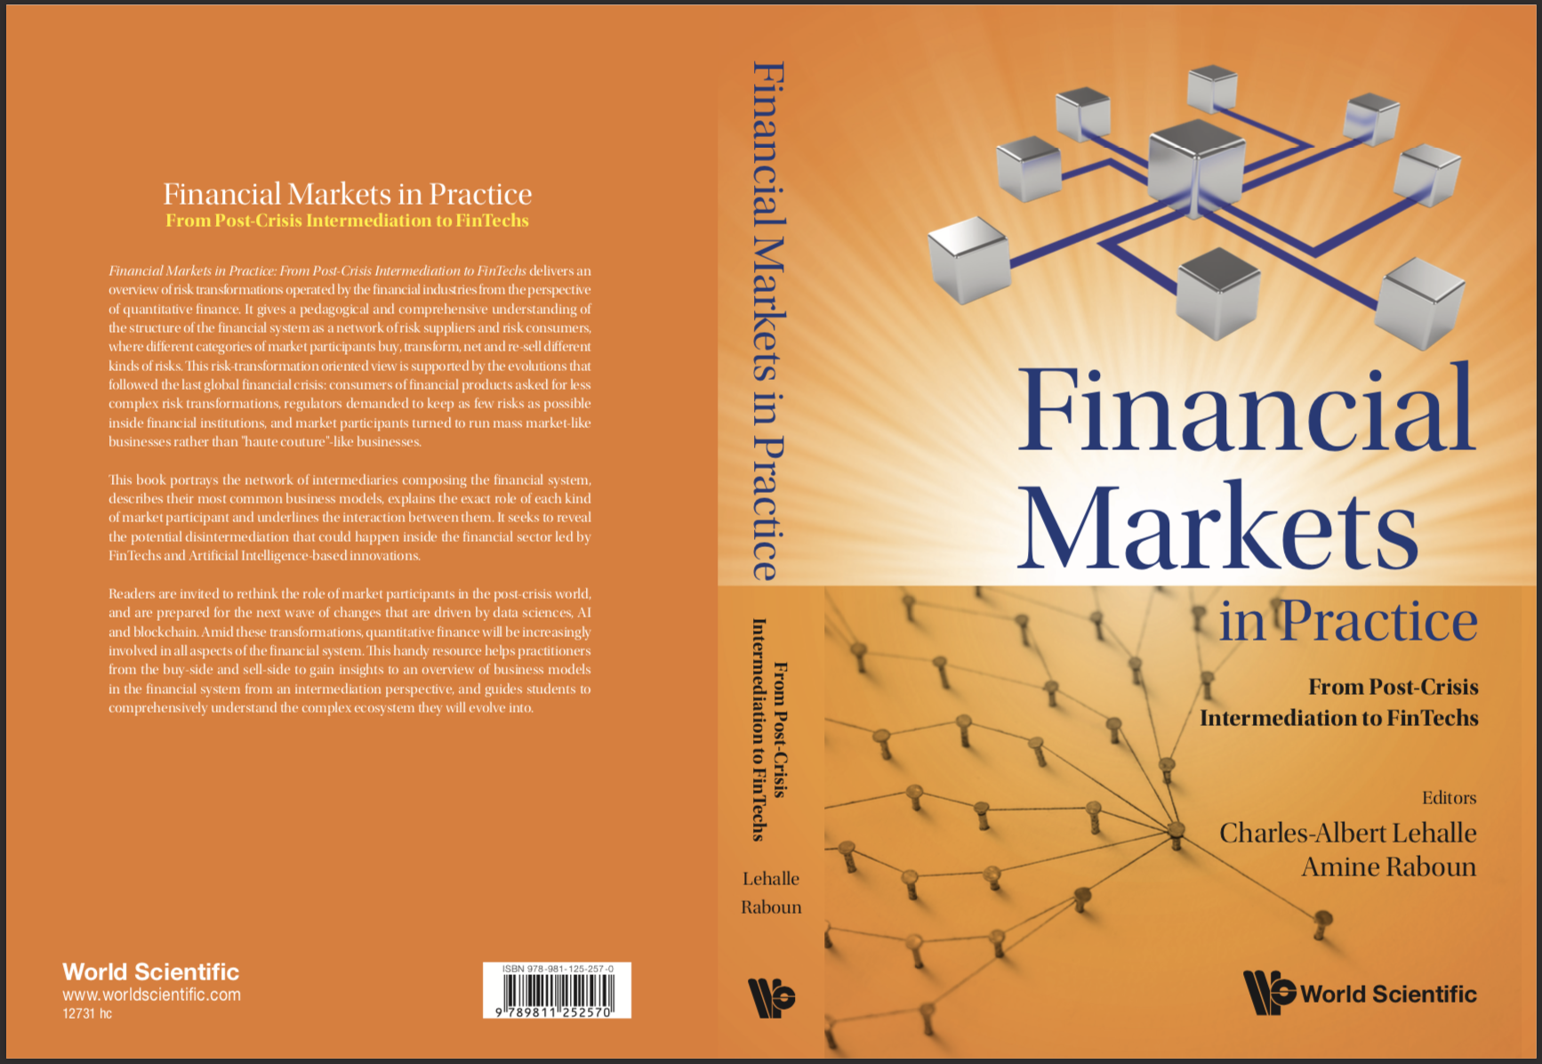
To go further
To go further:
Financial Markets in Practice:
From Post Crisis Intermediation to FinTechs
by Charles-Albert Lehalle
and Amine Raboun

